Slide 1
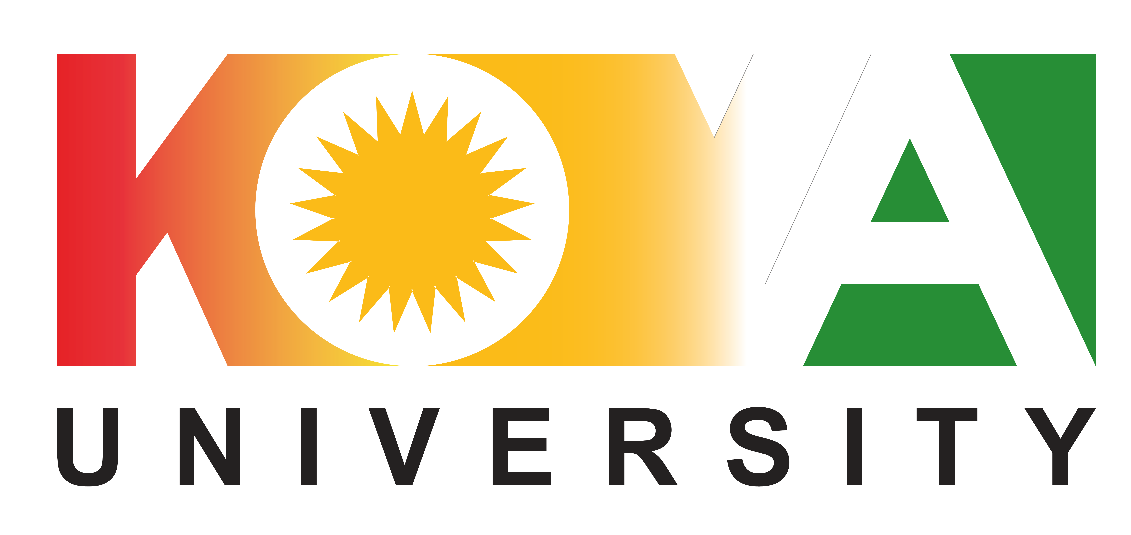
Kurdish language in Kurdistan Region - Iraq
Hewa S. Khalid
PhD in Kurdish language teaching

Slide 2
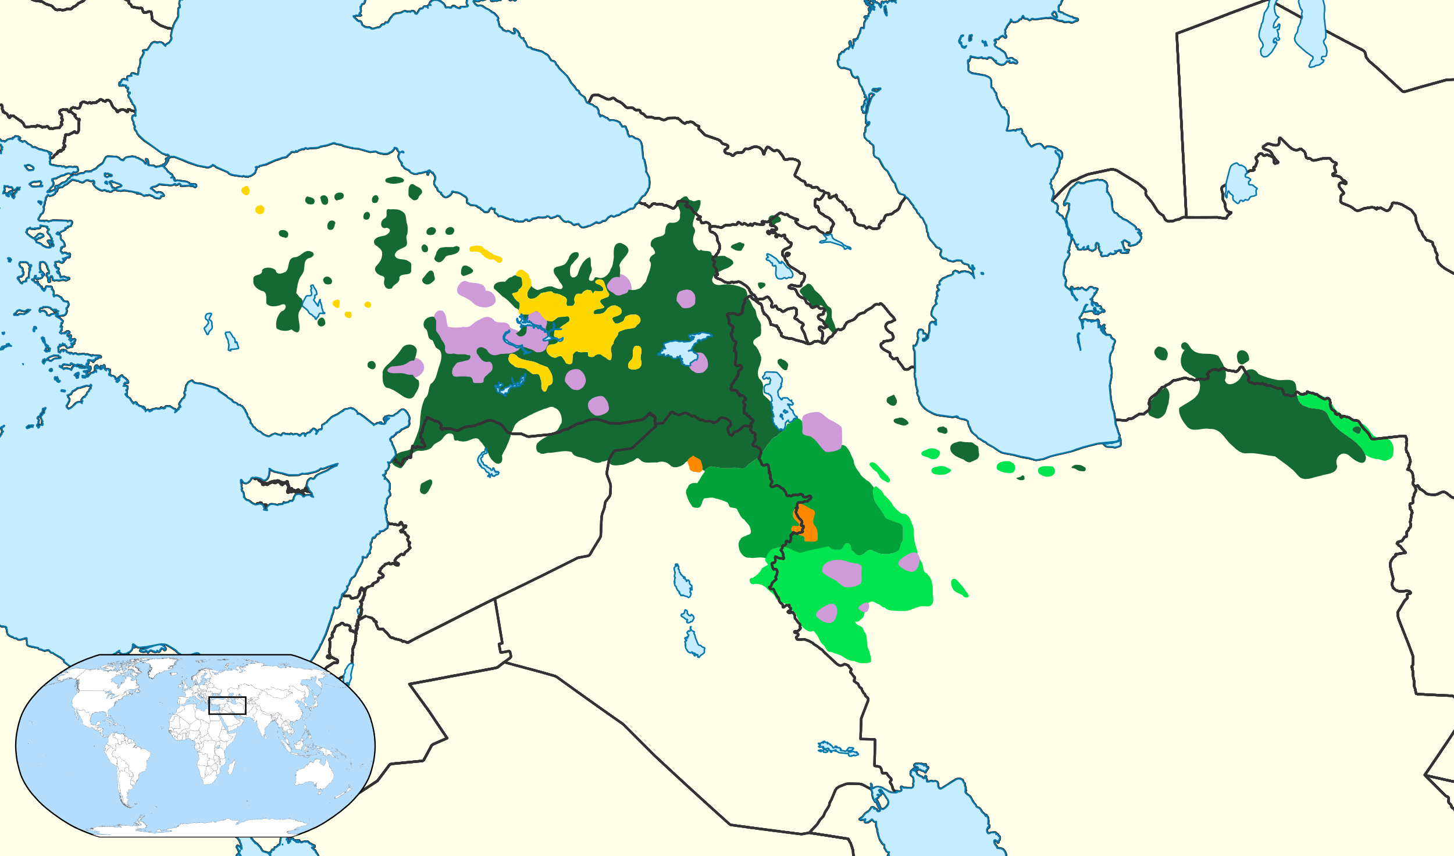
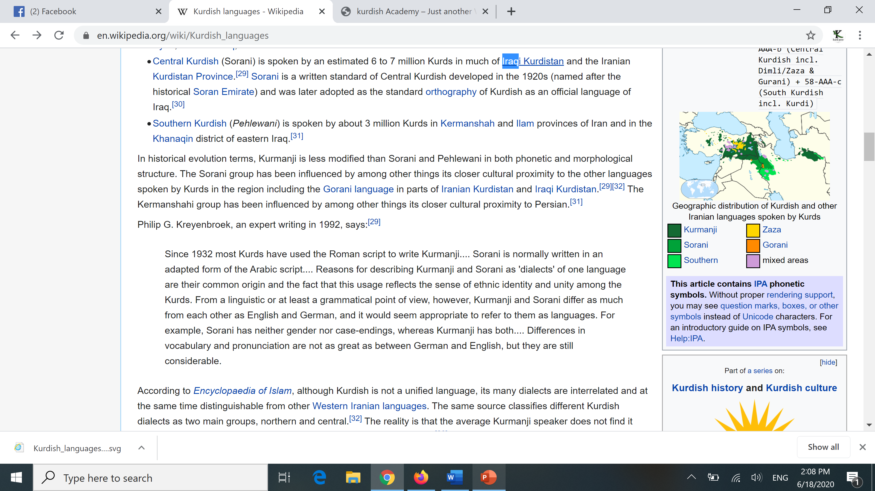
The dialects of Kurdish language
Turkey
Syria
Iran
Iraq
Northern Kurdish (Kurmanji)
Gorani - Zazaki
Central Kurdish (Sorani)
Southern Kurdish
Mixed areas
Hewa S. Khalid

Slide 3
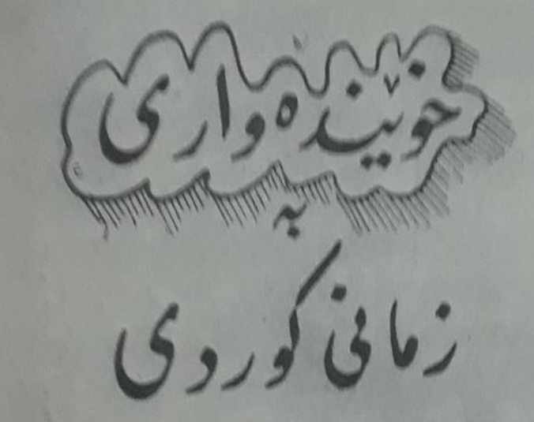
A brief history
After the collapse of the Ottoman Empire, this part of Kurdistan linked to Iraq. Iraqi Kurds revolted and asked for their rights, and the British mandate of Iraq also agreed to provide some cultural and linguistic rights. The British authority printed Peshkawtn newspaper in Sulaymaniyah, which has had a great impact on Kurdish language. (It is discussed that the British mandate supported Kurdish to use it against Arabic and Turkish politically)
Sulaymaniyah was the center of Kurdish nationalism in Southern Kurdistan. So, the dialect of Sulaymaniyah has become the language of intellectuals at that time.
After the Iraqi revolution and changing Iraqi system in 1958, the directorate of education in Kurdish was opened in Baghdad.
One of the main points in Kurdish-Iraqi peace process 1970 was studying in Kurdish language. So, the language of education in Sulaymaniyah, Erbil, and some parts of Kirkuk changed into Kurdish, while later some tribes in Duhok refused Kurdish education.
After the 1991 Kurdish uprising in Iraq, Kurdish become formal language of Kurdistan Region of Iraq.
According to the latest Iraqi constitution (2005), both Arabic and Kurdish are the formal languages of Iraq.
Hewa S. Khalid

Slide 4
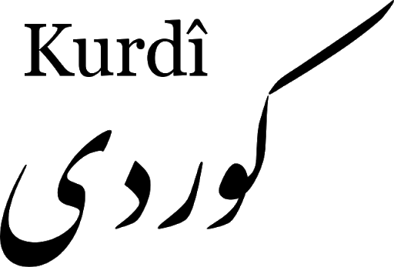
Education and governance is in Kurdish, but which dialect?!
Because of historical facts, political activities…etc. Central Kurdish has become the unrecognized formal language of Kurdistan Region.
Bahdini, which is one of the Kurmanji sub-dialects also wanted to compete. With the support of the KDP that its leaders are Bahdini speakers, they changed their education into Bahdini in Duhok province. While the same chance has not given to the other dialects, for example Hawrami and Southern Kurdish.
The key problem there is that the education in Duhok is not in the standard Kurmanji, it is in an accent of Kurmanji, which raise a new issue.
Hewa S. Khalid

Slide 5
The alphabet
Central Kurdish, Southern Kurdish and Gorani dialects use modified-Arabic alphabet, while Northern Kurdish and Zazaki use Latin alphabet except of Bahdini sub-dialect of Kurmanji.
So, the alphabet has become the contemporary issue of Kurdish language.
A group of Kurdish scholars (mainly in Iraqi Kurdistan) have signed a petition in 2012 to recognize Central Kurdish and its alphabet as a standard Kurdish language formally. While another group (mainly in Turkey Kurdistan) rejected their petition and asked KRG to not accept such demands.
Hewa S. Khalid

Slide 6
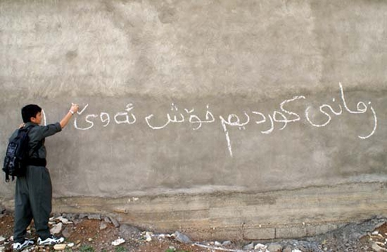
The last situation
Nowadays, other Kurdish dialects are under Central Kurdish influence. Education, higher education, printing and governance is mainly in Central Kurdish. It is written on Iraqi documents as well, like passport, ID and so on.
Both Gorani and Southern Kurdish in Iraqi Kurdistan are slowly melting within Central Kurdish. According to UNESCO, Hawrami (a sub-dialect of Gorani) is one of the endangered languages and its speakers have started to convert into Central Kurdish.
Hewa S. Khalid

Slide 7

Mutual Understanding
Some of the researchers stated that Kurdish dialects are not mutually understandable. While the case is different in Iraqi Kurdistan
The Kurds in other parts cannot use their language in education. Kurmanji had been banned in public in Turkey for many years. So, if the dialects have understanding problem there, one cannot generalize it for other parts of Kurdistan. According to my latest research, Kurdish dialects in Iraqi Kurdistan are mutually understandable, and Central Kurdish plays as a lingua franca.
Hewa S. Khalid

Slide 8
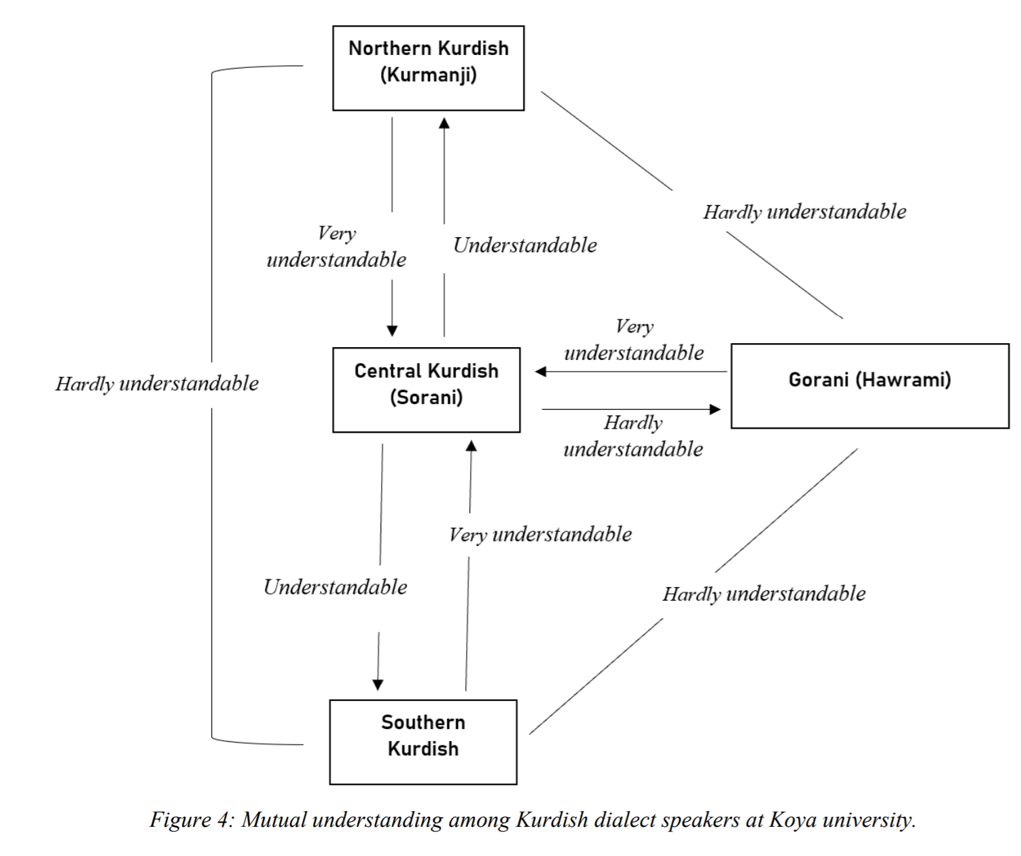
Hewa S. Khalid

Slide 9
Thanks for your attention
Hewa S. Khalid

